Slide 1
NEST STAGE DESIGN
Default Push Link
StageSubset：X
Process
A
Process
B
EnterProcess＝A
ExitProcess＝B
ProcsAdd()
ProcsRemove()
FindProcess()
Add/RemoveWorkInReserve()
GetWorkInReserve()
Enter/ExitWorkToProcess()
GetWorks()
Add/GetProcessLinks()
DI
ClassModel
Model
Stage : st
X
X
A
B
C
A
B
Engine
w1

Slide 2
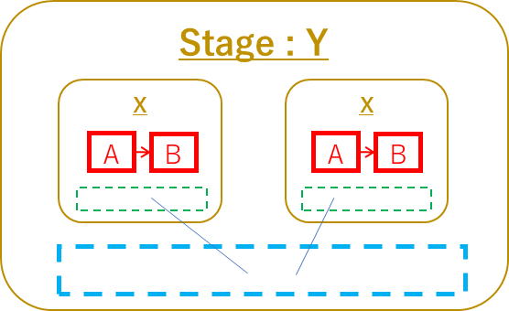
NEST STAGE DESIGN
Default Push Link
StageSubset：X
Process
A
Process
B
EnterProcess＝A
ExitProcess＝B
ProcsAdd()
ProcsRemove()
FindProcess()
Add/RemoveWorkInReserve()
GetWorkInReserve()
Enter/ExitWorkToProcess()
GetWorks()
Add/GetProcessLinks()
DI
ClassModel
Stage : Y
Stage : Z
X
X
X
A
B
A
B
A
B
DoNext()
Events
Now
SendKanban

